Slide 1
Data Science Journey at Statistics Canada
Digital Academy
May 2, 2019

Slide 2
Agenda
StatCan Data – Access, Data Integration
Innovation Ecosystem – Kathryn Stevenson
Data Science Accelerator – Christie Sambell
Data Science Centre of Excellence – Yanick Beaucage
Open Data – Alessandro Alasia
Questions, Discussion

Slide 3
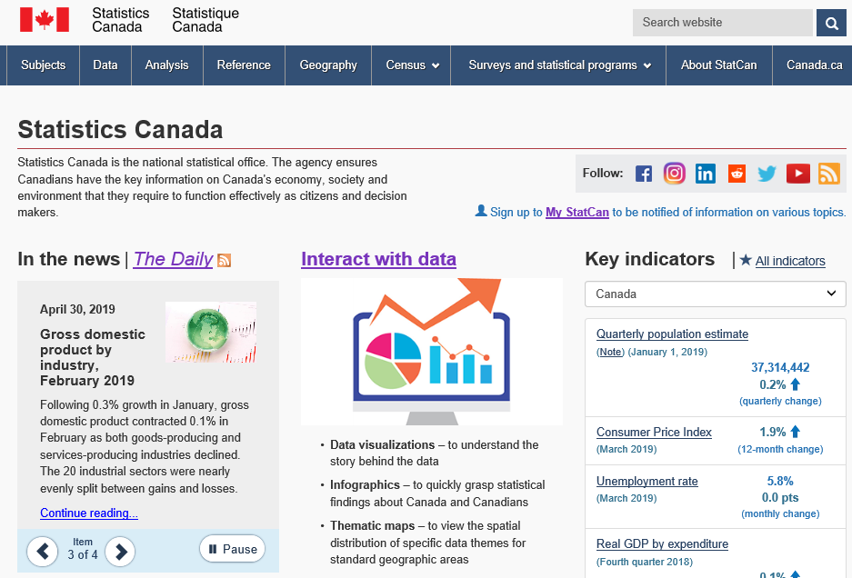
Data Access – Navigating the StatCan website
https://www.statcan.gc.ca/eng/start
Notes:
Approximately 1.5 million visits on monthly basis
30% of visits to the site from mobile devices
55% of visits to the site from google
2018 Website evaluation survey:
73% of survey participants were satisfied with our website
76% completed their task successfully and found what they were looking for

Slide 4
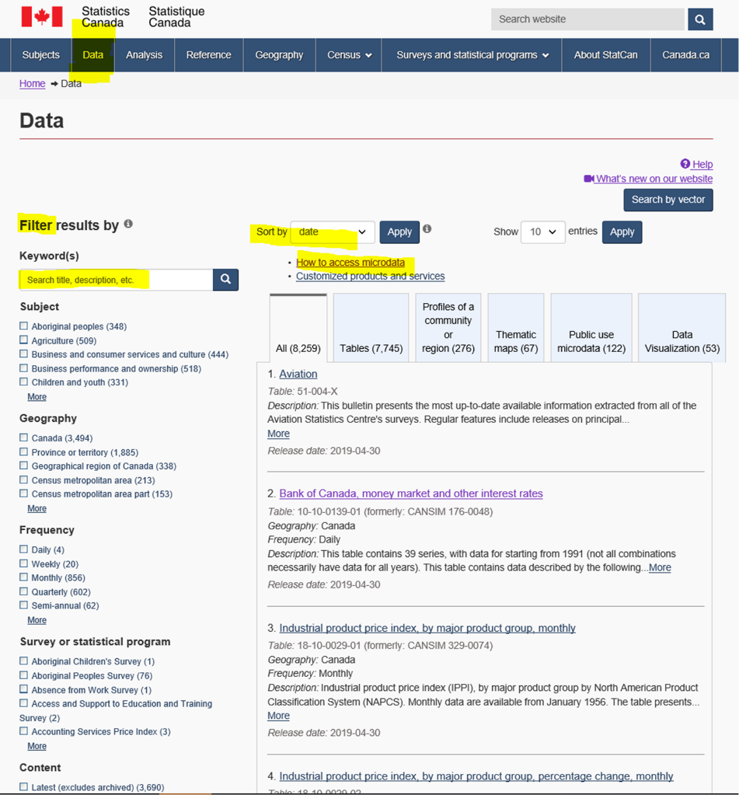
Navigation pathways
By Data:
Features
Filters
Sorting
Keywords
How to access microdata
By Analysis
By reference
By Census
By surveys

Slide 5
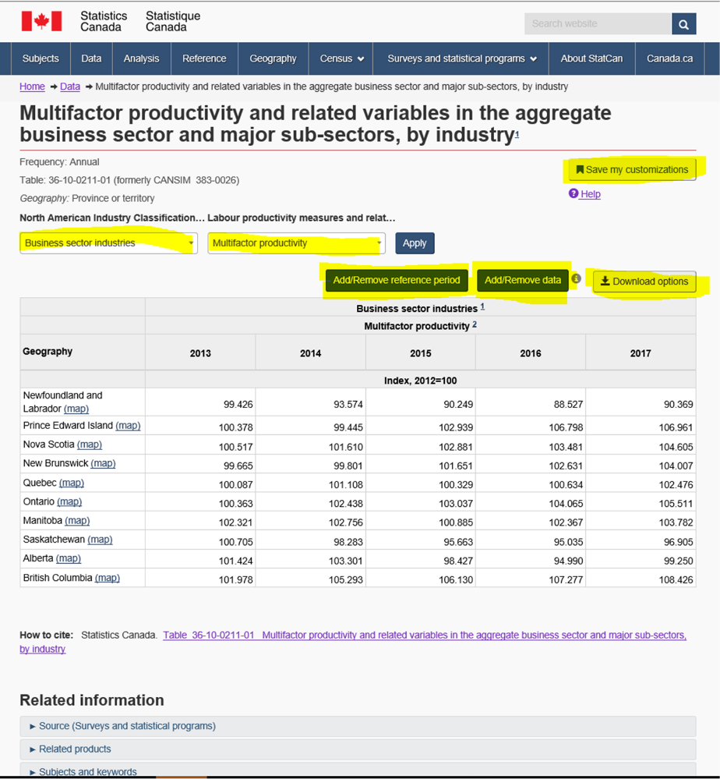
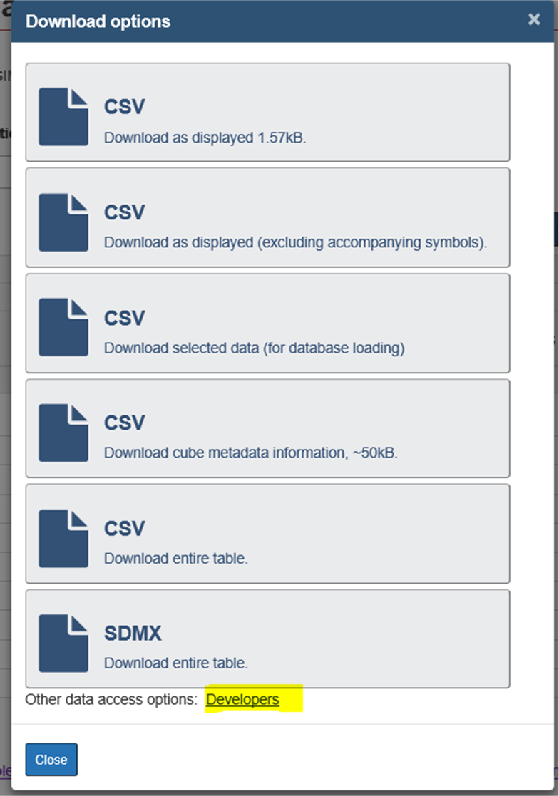
Tables

Slide 6
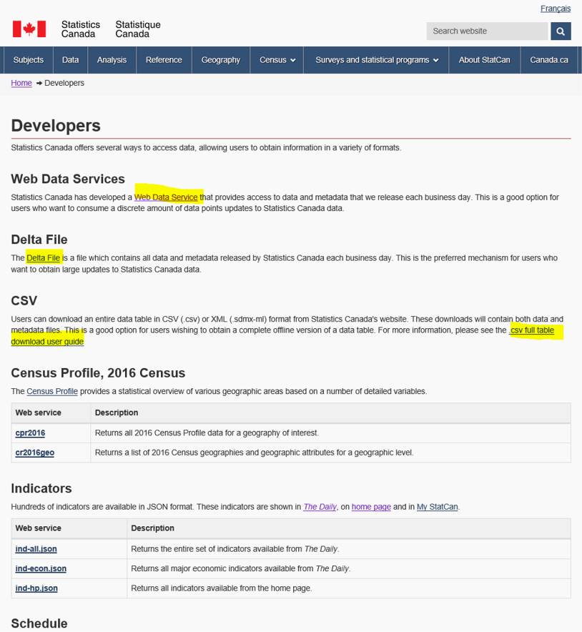
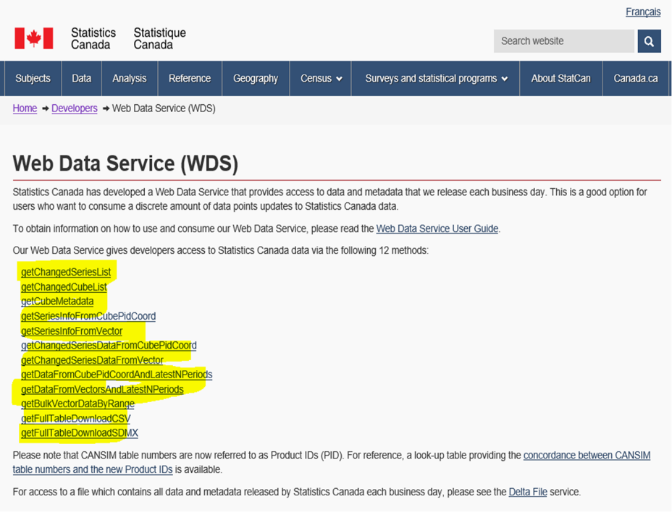
Web Data Service/API
https://www.statcan.gc.ca/eng/developers

Slide 7
Links
Watch live video about: What’s new on our website https://www.statcan.gc.ca/eng/sc/video/new
Watch live video about: How to use the data tables
https://www.statcan.gc.ca/eng/sc/video/howto

Slide 8
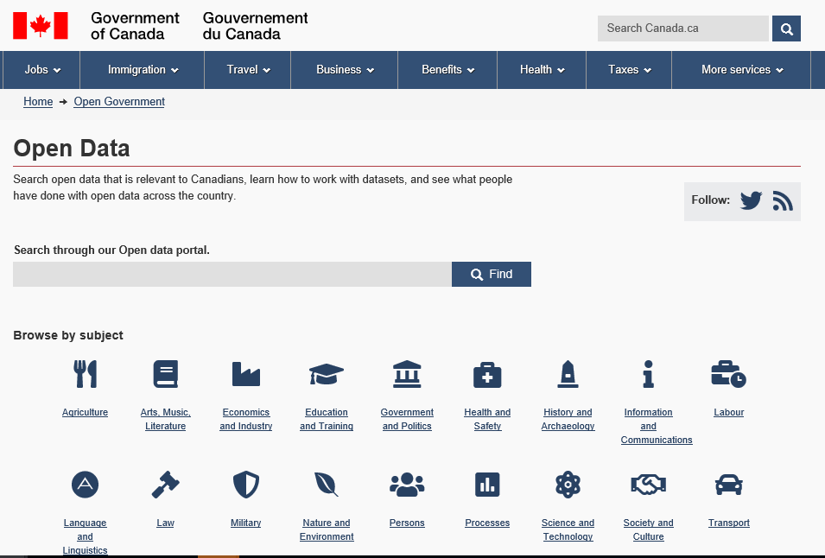
75%
of non-geospatial files on the portal are from Statistics Canada.
https://open.canada.ca/en/open-data

Slide 9
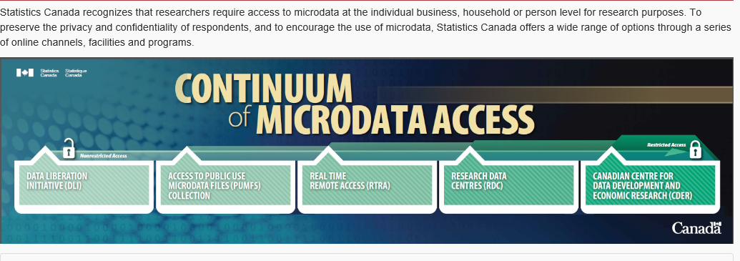
Access to microdata

Slide 10
Accessing data at the Federal Research Data Centre
RDCs are secure computer laboratories that house Statistics Canada microdata master files
Researchers are deemed employees of Statistics Canada
Major statistical software packages
Vetted results are sent to researchers
Staffed by Statistics Canada employees

Slide 11
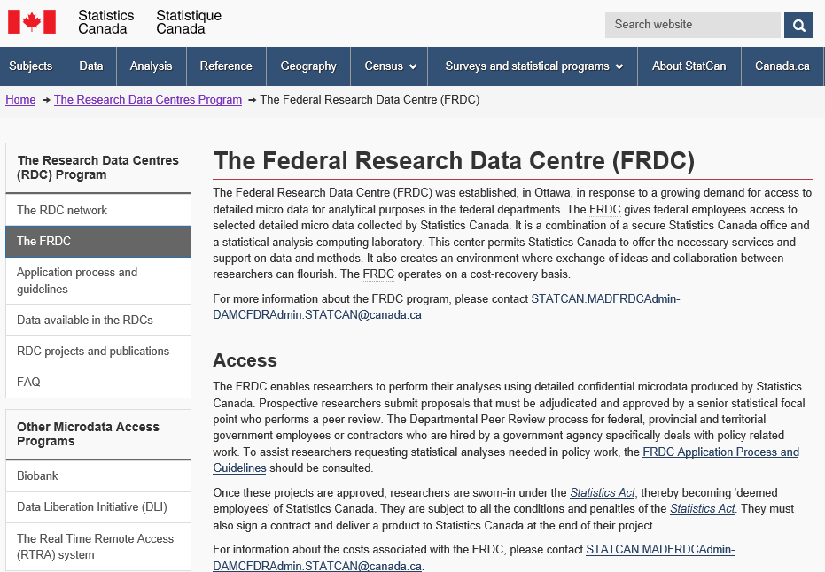
Access to microdata (persons)
https://www.statcan.gc.ca/eng/rdc/frdc

Slide 12
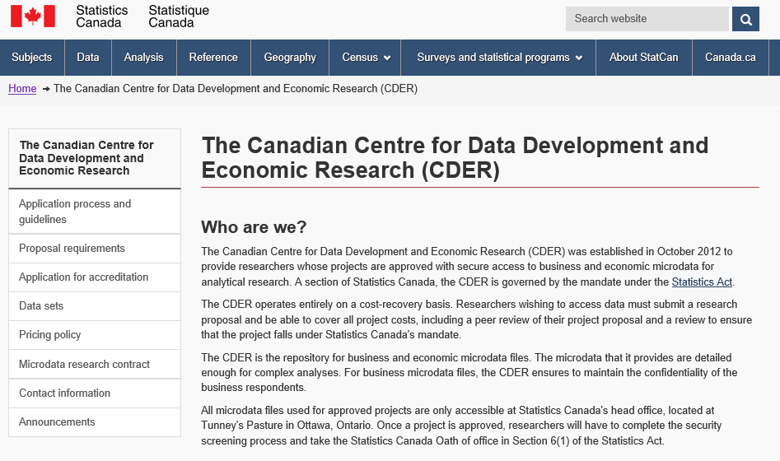
Access to microdata (businesses)
https://www.statcan.gc.ca/eng/cder/index

Slide 13
Statistics Canada Modernization – Data Integration key to the future
Responsive
Moving beyond a survey-first approach with new methods and integrating data from a variety of existing sources
User-centric
Making data easier to access and use by adopting new tools to analyze and visualize data
Relevant
Enabling Canadians to use data to make evidence-based decisions
Enabling efficient data management and access

Slide 14
Environment and Health (CanCHEC)
Mean PM2.5 estimates in Canada from 1998-2010 derived from
satellite imagery at 1km x 1km resolution
Exposure to even very low amounts of PM_{2.5} over long periods may pose greater risk than originally assumed –
Future plans… focus on impact of built environment on health – walkability, greenspace
Cause of death | Risk of death HR (95% CI)
Non-accidental | 1.26 (1.19,1.34)
Respiratory | 1.52 (1.26, 1.84)
COPD | 1.40 (1.09, 1.80)
Pinault L, Weichenthal S, Crouse DL, et al. 2017. Associations between fine particulate matter and mortality in the 2001 Canadian Census Health and Environment Cohort. Environmental Research.159: 406-415
Notes:
Data Source: CanCHECs
Notes:
-Statistics Canada has been working collaboratively with the Air Health Effects Research Group at Health Canada to build data infrastructure and evidence linking air pollution exposure and health outcomes to inform air quality regulation.
-This innovative work brings together modelled air pollution measures from satellite imagery provided by HC and external researchers with linked survey, mortality and tax data to follow individuals’ place of residency over time, to measures exposure to and impact of air pollution on mortality.
-Findings suggest that lower levels of air pollution may have more impact than originally assumed. This may impact regulations moving forward.
-Statistics Canada is increasing both data development and capacity to better understand the impact of the environment on health and other social outcomes.
-We will be working more in the upcoming year on measures of and impact of the built environment.
-Specifically, we will be using the Active Living (walkability) measure developed by McGill researchers (Nancy Ross) based on funding from PHAC to better understand the relationship between walkable neighbourhoods and health

Slide 15
Immigrant Health
Rate of tuberculosis (TB) related hospitalization among immigrants landing between 2000-2013 by source country, Canada
(excluding Quebec)
1,120 out of 2.7 million immigrants arriving between 2000 and 2013 were found to have at least one TB related hospitalization
97% were among immigrants from higher risk countries - Ethiopia, Somalia, Nepal, India and the Philippines.
The majority of cases occurred among those admitted as either refugees or family class
Rate per 100,000 person years
Source: Ng E et al. Tuberculosis-related hospital use among recent immigrants to Canada. Health Reports (Forthcoming, July 2018)
Notes:
Data Surce: IMDB linked to hospital data
-This slide represents new results from a collaborative program of research between Statistics Canada and IRCC to better understand the health of immigrants and evaluate screening policies and practices.
-Tuberculosis in Canada is more prevalent among new immigrants compared with Canadian born (non-Indigenous) populations. IRCC conducts an extensive health screening protocol for all new entries into Canada.
-New linked data which brings together comprehensive information from landing files provided to STC by IRCC with hospital data provided to STC from CIHI, new insights regarding infectious diseases such as TB as possible at the national level. While, these results do not represent ALL TB cases but those only that were admitted to hospital, representing most of the active cases.
-The results of this studies confirm that TB related hospitalizations among immigrants entering Canada between 2000 and 2013 – with most cases coming from countries deemed high risk for TB by the WHO and IRCC including Ethiopia, Somalia and Nepal.
-These results are informing IRCCs pre-arrival screening strategy. This study will be published in Health Reports in the coming year.

Slide 16
Inter-provincial employment (LWF)
In 2014, 5.4% ($8.0 billion) of total aggregate earnings paid in Alberta was paid to out-of-province employees
Source: The Daily. Estimates of inter-jurisdictional employment in Canada by province and
territory, 2002 to 2014. December 20 2017
Notes:
Data Source: Longitudinal Worker File
Inter-provincial employment
Anecdotal information about workers commuting inter-provincially to jobs in Alberta captured headlines during the oil boom
Survey data collection was cost-prohibitive given worker mobility, remote locations, and other factors
Administrative data provide detailed information with minimal financial cost
In 2014, over 8% of total T4 earnings received by residents of Newfoundland-Labrador was received from out-of-province, with that share over 20% in some areas. Two-thirds was received from Alberta
In 2014, 5.4% (or $8.0 billion) of total aggregate T4 earnings paid in Alberta was paid to out-of-province employees
The LWF is a 10 percent random sample of all Canadian workers, constructed by integrating data from four sources: the Record of Employment (ROE) files of Human Resources Development Canada (on worker separations), the T1 and T4 files of Canada Customs and Revenue Agency, and the Longitudinal Employment Analysis Program (LEAP) of BLMA, Statistics Canada.

Slide 17
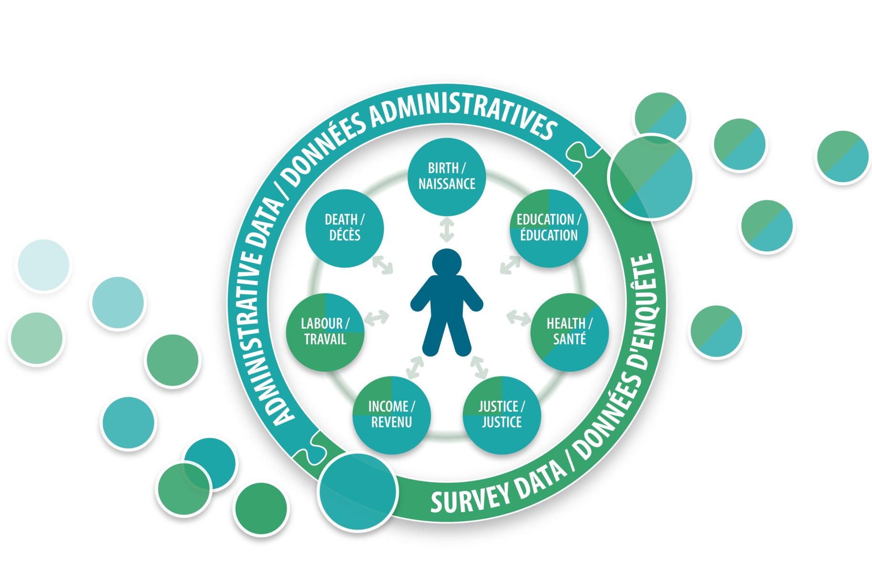
Record Linkage @StatCan
Canadian Employer-Employee Dynamics Database (CEEDD)
Longitudinal Worker File (LWF)
Canadian Housing Statistics Program (CHSP)
Longitudinal Employment Analysis Program (LEAP)
Linked
File Environment (LFE)
Social Data Linkage Environment (SDLE)
CanCHEC
National Accounts Longitudinal Microdata File (NALMF)
https://www.statcan.gc.ca/eng/record/gen
Notes:
Statistics Canada has a long history of record linkage. Over the past decade, the number of record linkage projects has increased exponentially. As the Agency has moved on a path of modernization, data integration, specifically record linkage, is key to the development of new data sources to fill information gaps as we move forward.
RL is conducted at Statistics Canada to supplement survey information and increasingly, to create new data resources to produce official statistics and support research.
RL simply put is the process of matching records across or within datasets that refer to the same entity, such as a person or enterprise. We do use a range of key identifiers (names, addresses, date of birth, location, unique numbers (HIN, SINs, Business numbers).
Processes used to link data at Statistics Canada are followed to ensure the confidentiality of information is protected and privacy intrusion is minimized. Executive management approval is required for all linkage project. RL Projects are governed by policies and directives.
Several platforms have been developed at Statistics Canada to facilitate linkage – Canadian Employer-and Employer Database which brings together tax and employment records from both employees and employers; the Social Data Linkage Environment (SDLE) was created to support linkages at the individuals level across a broad spectrum of social data (health, justice, education, socio-economic); and the Linkable File Environment for business data.
Notes on SDLE:
Social Data Linkage Environment (SDLE) exists in the Special Surveys Division SSD: Director-General is Lynn Barr-Telford.
Their goal is to deliver data that respond to the client’s information requirements, and to meet the information needs of Canadians that are not covered by the core national statistics program.
The Cost-recovery Surveys Section provides a complete cost-recovery survey service that covers the full survey cycle from specifying needs to evaluating the data and data products.
SSD conducts feasibility studies; and undertakes survey development, testing, collection, processing and dissemination of the data, as required by the client.
SSD survey managers have extensive experience working with clients and internal service providers.
Social Data Linkage Environment- We have created a new linkage environment at STC – SDLE – to support the RL – conducted in a more efficient and standardized manner.
The Social Data Linkage Environment (SDLE) facilitates the creation of linked population data sets for social analysis and is designed to maximize data security and eliminate the need to build a large integrated data base.
The SDLE is designed to bring person-level data together in one virtual linkage environment – facilitates the linkage of multiple types of data sources.
We do not always have the same linkage information in every data source .
These data may come from either administrative sources or surveys (large circle). Inside this large circle are seven interconnected circles which display the range of subjects possible in the SDLE.
In addition, the colors show the approximate proportion of administrative (blue) and survey (green) data available at Statistics Canada. These circles point towards the image of a person in the middle,
which represents the person-oriented nature of SDLE linkages and the ability to link individuals across multiple sources. Finally, data sources exit the environment on the right side as linked outputs.
Data files are linked together through linkage keys that are stored in the Derived Record Depository (DRD) and the Key Registry. The DRD is essentially a registry of Canadians containing only basic personal identifiers.
The DRD is built using core administrative data files (vital statistics, tax and immigration files) and each individual is assigned a unique SDLE identifier.
We have done this because we do not have a registry of the population as you might find in provinces through health card files or other administrative files. Every file linked in the SDLE is linked to the DRD.
The Key Registry stores only the SDLE identifiers and associated record identifiers from all survey and administrative data files linked to the DRD.
Once a study requiring data linkage has been approved and the linkage has been conducted, the Key Registry identifiers are used to find the individual records in the source data files (analysis variables without personal identifiers). Selected records and variables from these sources can then be integrated into a linked analysis file.

Slide 18



Thank you….
Claudia.Sanmartin@Canada.ca
Analytical Studies Branch
www.statcan.gc.ca
#StatCan100

